Slide 1

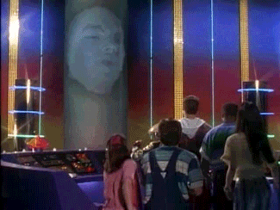








Slide 2
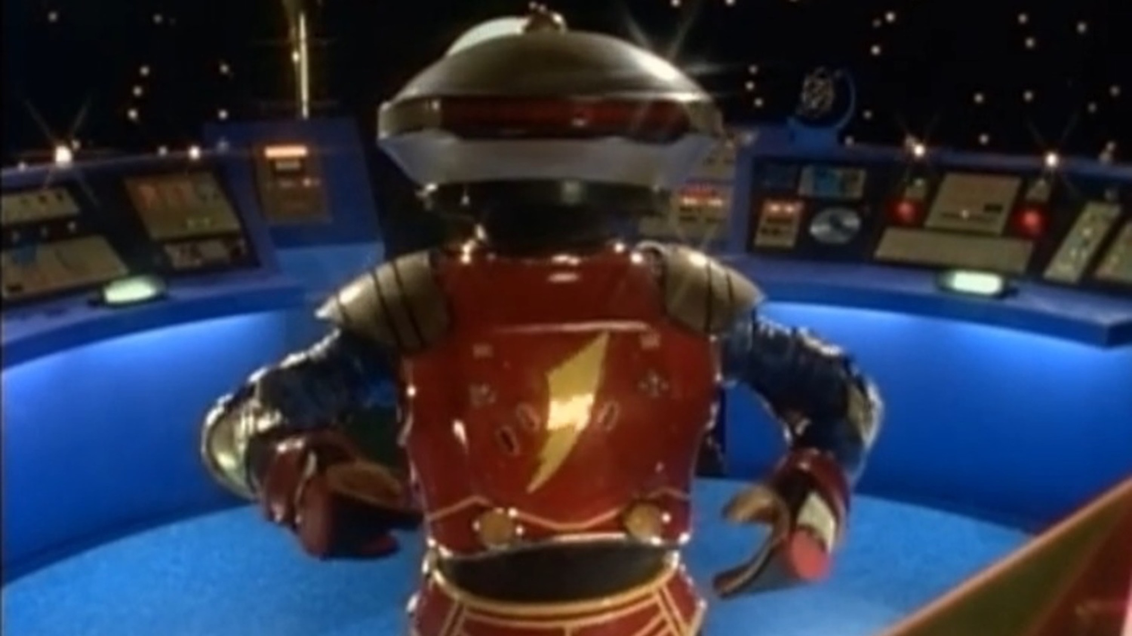
SciBot: A Data Science Research Bot — Data Science Course Project
http://powerrangers.wikia.com/wiki/Alpha_6
Meng Jiang
Data Science

Slide 3
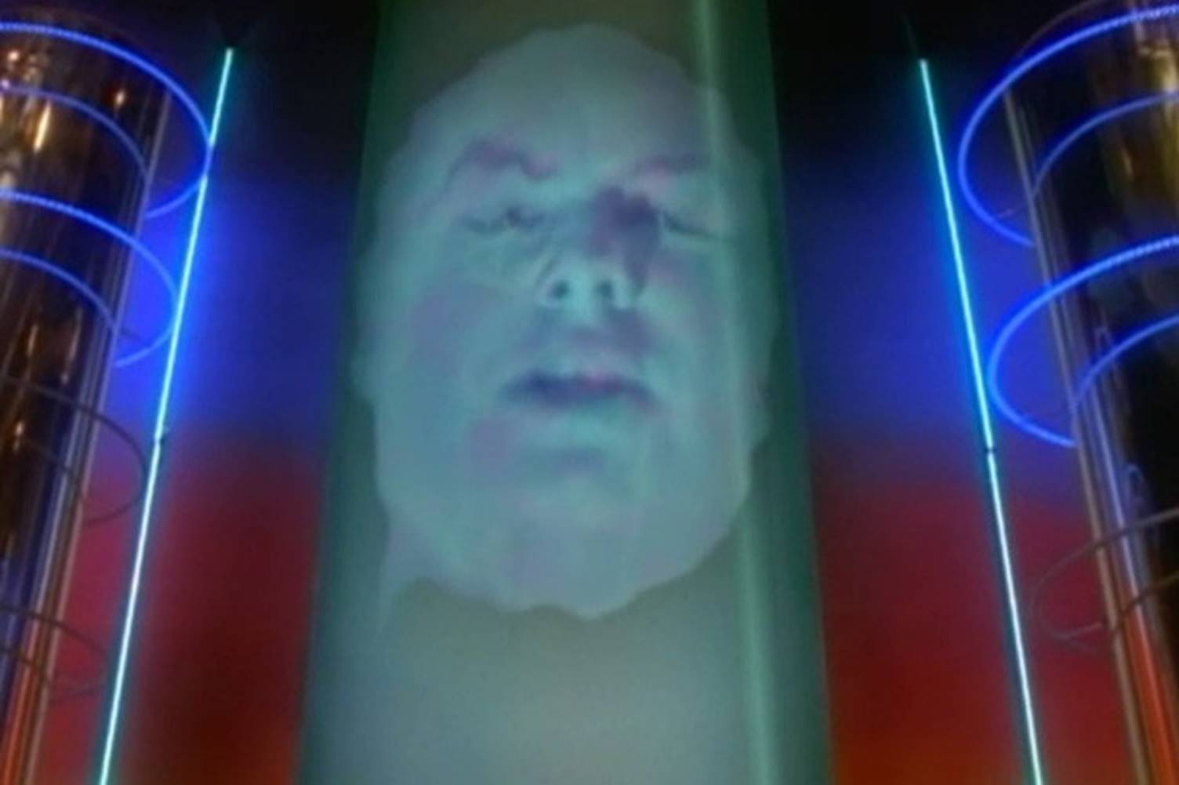
Dr. Zordon: Alpha, find me a data scientist!
http://powerrangers.wikia.com/wiki/Zordon

Slide 4
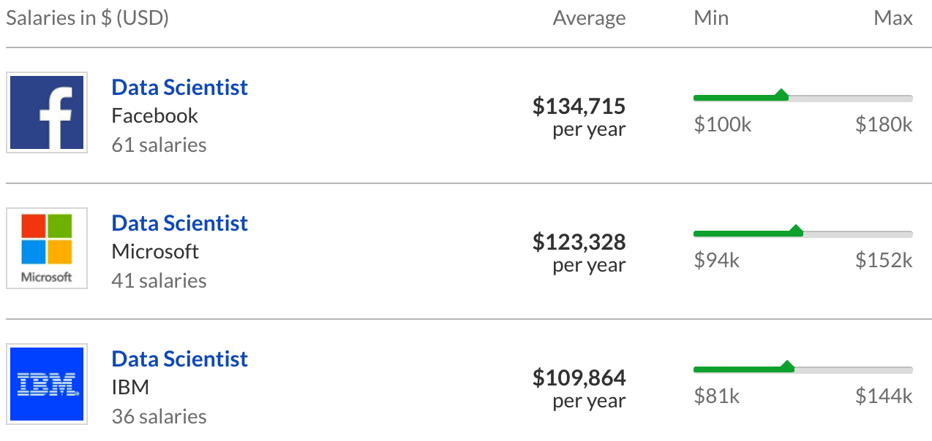
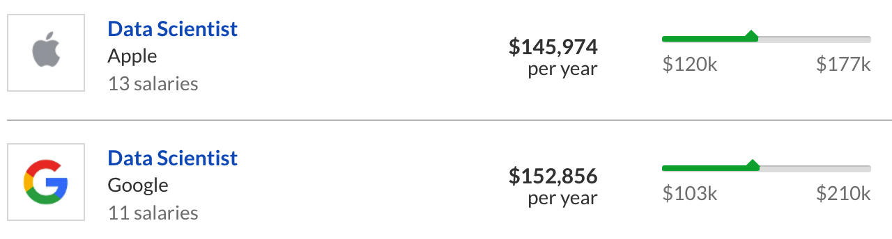
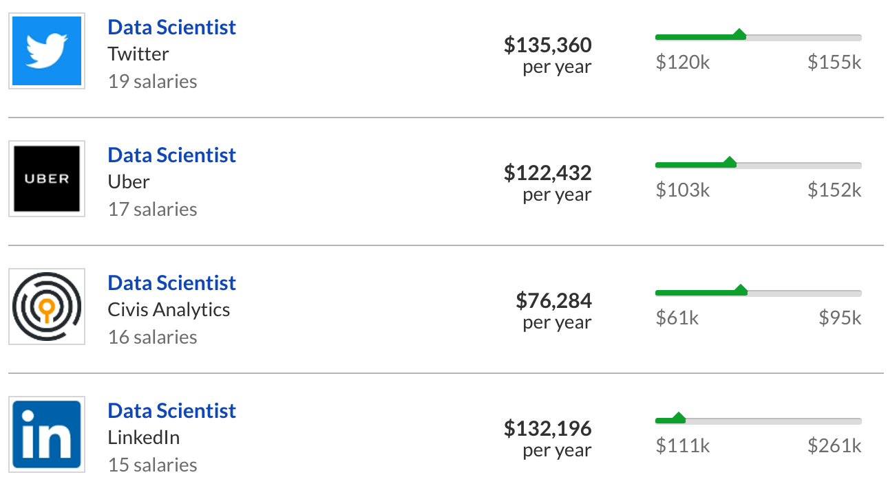

They are
too expensive!
https://www.glassdoor.com/Salaries/data-scientist-salary-SRCH_KO0,14.htm

Slide 5
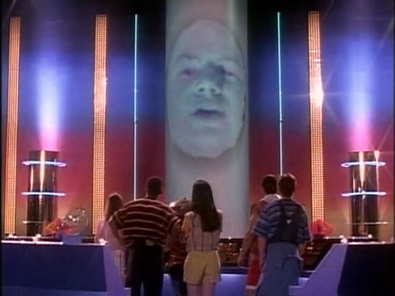
How many data science papers have you read?
(#papers cited in your PhD thesis)
172
120
185
210
256

Slide 6
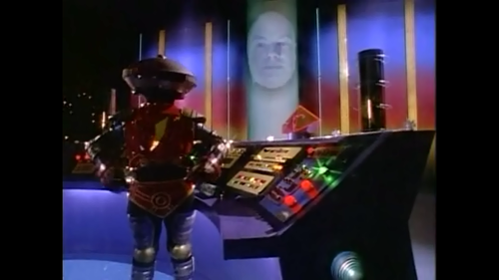
How many papers we grabbed from the web?
5,853 papers from 4 data science conferences!

Slide 7

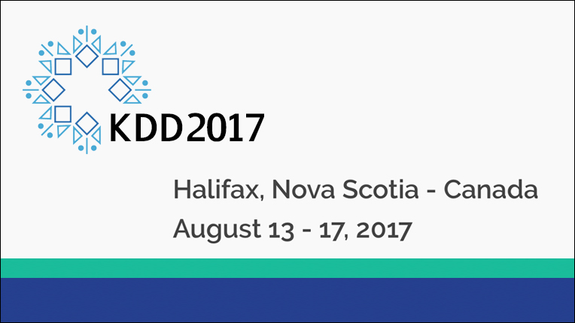








KDD: ACM SIGKDD Conference on Knowledge Discovery and Data Mining (August)
1994 – 2015: collected 1,646 papers
’16: San Francisco; ’17: Halifax, Canada; ’18: London
Due: February
ICDM: IEEE International Conference on Data Mining (December)
2001 – 2015: collected 881 papers
’16: Barcelona; ’17: New Orleans
Due: June
WWW: International World Wide Web Conference (April)
2001 – 2015: collected 2,975 papers
’16: Montreal, Canada; ’17: Perth, Australia; ’18: Lyon, France
Due: October
WSDM: ACM International Conference on Web Search and Data Mining (February)
2008 – 2015: collected 351 papers
’16: San Fancisco; ’17: Cambridge, UK; ’18: Los Angeles
Due: August

Slide 8
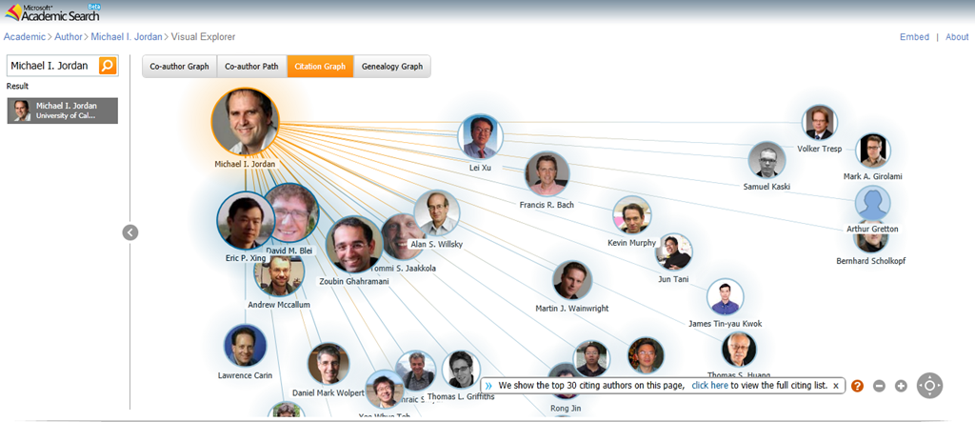
Dataset Introduction
pdf (5.5G): https://www.dropbox.com/s/460h772tpuceew5/pdf.zip?dl=0
“icdm01-d3.pdf”
Not recommended
text (270M): https://www.dropbox.com/s/o0f7qjb5mobmfvt/text.zip?dl=0
“icdm01-d3.txt”
Recommended to skip the REFERENCES section.
microsoft (100M): https://www.dropbox.com/s/o9qzhbdd0pmk5wm/microsoft.zip?dl=0
index.txt: PID, PDFID
Papers.txt: PID, TITLE, YEAR, CONF
PaperKeywords.txt: PID,KEYWORD
PaperAuthorAffiliation.txt: PID,AID, FID, AFF, SID
Authors.txt: AID, AUT

Slide 9
How long does it take you to read all the five thousand papers?
5853 / 365 / 5 = 3.207 years…

Slide 10
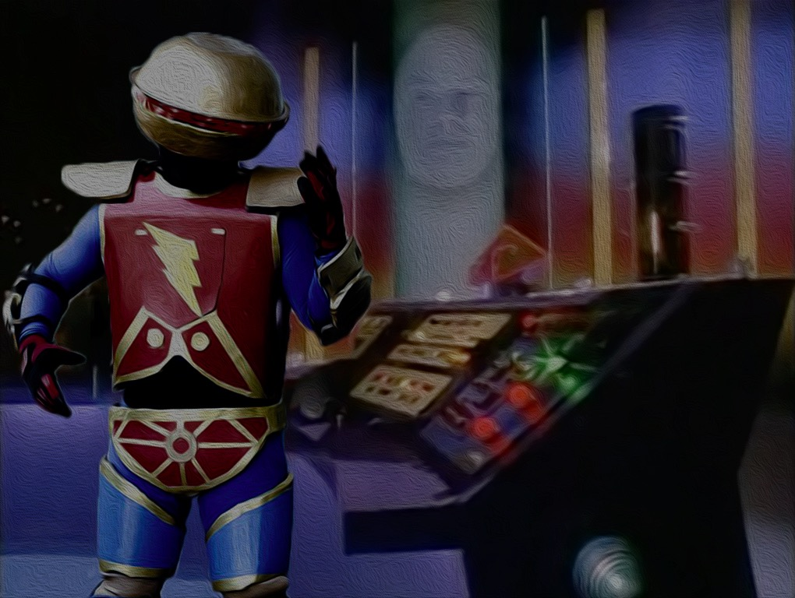
Dr. Zordon: Alpha, how about this… You read and understand the 5,853 papers. For now, you are my SciBot!
Alpha: That’s easy!

Slide 11
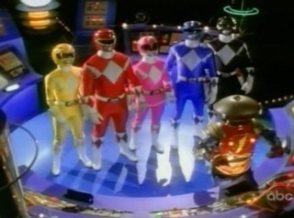
Author | #paper
jiawei han | 94
philip s yu | 82
christos faloutsos | 64
jieping ye | 42
ravi kumar | 41
jure leskovec | 40
Word | #
the | 2,154,841
of | 1,127,177
and | 818,732
a | 797,101
in | 727,085
to | 718,857
Am I a smart Bot?
Char | #
e | 20,953,911
t | 14,791,644
i | 12,864,269
a | 12,716,160
o | 11,753,274
n | 11,673,479

Slide 12

Dr. Zordon: No!!! I’ll pay your training at Notre Dame CSE Data Science Course …
Alpha:

Slide 13
Data Science Research
Datasets
Data Cleaning
Data Integration
Application Problems
Informal Problem (Task) Definition
Notations
Formal (Learning?) Problem Definition
Task-Relevant Data Selection
Data Mining/Machine Learning
Knowledge (patterns, etc.)
Pattern evaluation
Notes:
Ask good questions. Data engineering and data science.

Slide 14
Seven Required Tasks: Task 4-7
Concepts and Methods:
Frequent pattern mining
Association rule mining
Classification
Clustering
Task 4: Collaboration discovery
Task 5: Problem-method association mining
Task 6: Problem/method/author-to-conference classification
Task 7: Paper clustering

Slide 15
Task 4
Concepts and Methods:
Frequent pattern mining
Association rule mining
Classification
Clustering
Task 4: Collaboration discovery
Task 5: Problem-method association mining
Task 6: Problem/method/author-to-conference classification
Task 7: Paper clustering
Given the paper/keyword/conference-author data, find frequent author-sets (as patterns): which two/three/four authors often collaborate together?
Techs: Frequent pattern mining (Apriori, FP-Growth).
Hints: Here each paper is considered as a transaction. Each author is an item.

Slide 16
Task 5
Concepts and Methods:
Frequent pattern mining
Association rule mining
Classification
Clustering
Task 4: Collaboration discovery
Task 5: Problem-method association mining
Task 6: Problem/method/author-to-conference classification
Task 7: Paper clustering
Given the paper-problem-method data, find strong association rules:
problem X → method Y, or
method X → problem Y,
of high support and confidence.
Techs: Association rule mining.

Slide 17
Task 6
Concepts and Methods:
Frequent pattern mining
Association rule mining
Classification
Clustering
Task 4: Collaboration discovery
Task 5: Problem-method association mining
Task 6: Problem/method/author-to-conference classification
Task 7: Paper clustering
Given a problem/method/author, predict if a conference has papers of it.
Techs: Binary classification (Naïve Bayes, Decision Tree).
Hints:
What are the attributes (features) you want to use?
How to set up training and testing? Please evaluate the performance on different features, different models, and different setups.

Slide 18
Task 7
Concepts and Methods:
Frequent pattern mining
Association rule mining
Classification
Clustering
Given a set of papers, cluster them into K groups.
Techs: K-partitioning clustering methods (K-Means).
Hints:
What are the attributes (features) you want to use?
Suppose K = 4 and the ground-truth is the conference. Please evaluate the performance on different features and different methods.
Task 4: Collaboration discovery
Task 5: Problem-method association mining
Task 6: Problem/method/author-to-conference classification
Task 7: Paper clustering

Slide 19
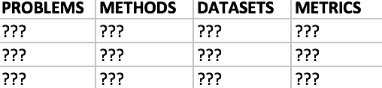
Seven Required Tasks: Task 1-3
Process raw data into clean, multi-dimensional tabulated data.
From structured tables
From unstructured paper text

Slide 20
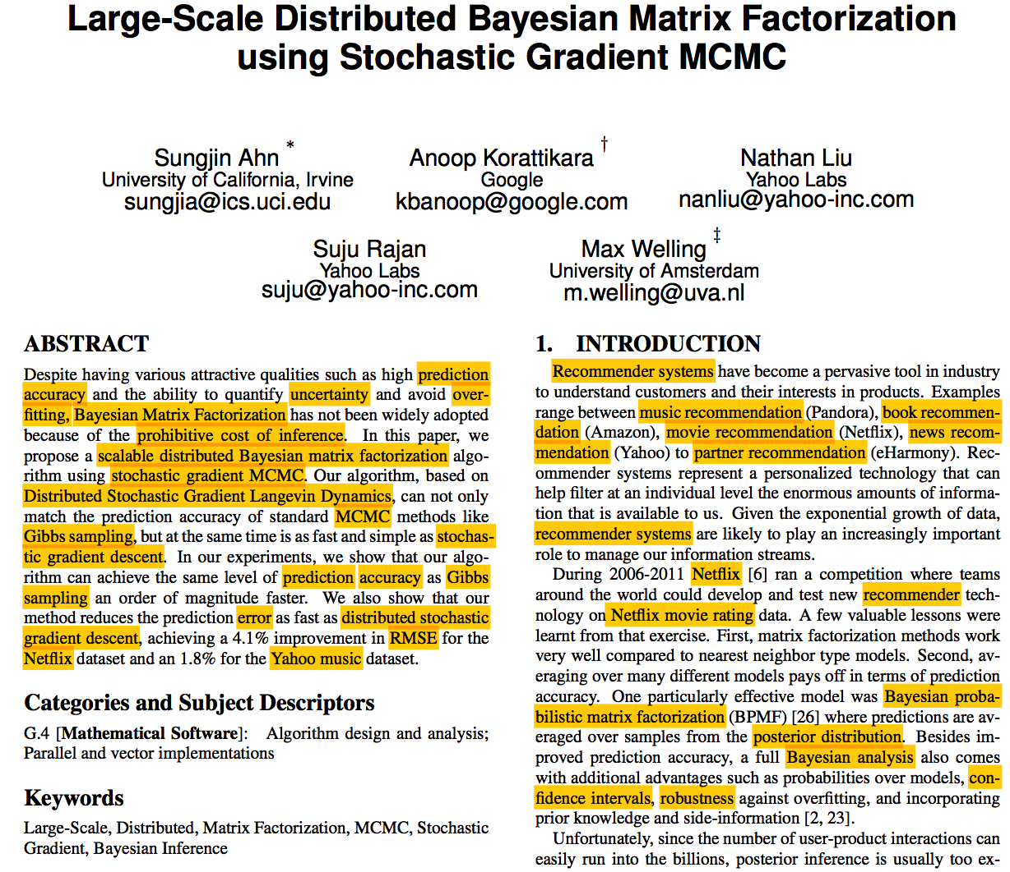
Dimension | Value | Dimension | Value
PROBLEM | prediction | DATASET | netflix
METRIC | prediction accuracy | DATASET | yahoo music
PROBLEM | uncertainty | PROBLEM | recommender systems
PROBLEM | over-fitting | PROBLEM | music recommendation
METHOD | Bayesian matrix factorization | PROBLEM | book recommendation
PROBLEM | prohibitive cost of inference | PROBLEM | movie recommendation
METHOD | scalable distributed Bayesian matrix factorization | PROBLEM | news recommendation
METHOD | stochastic gradient mcmc | PROBLEM | partner recommendation
METHOD | distributed stochastic gradient langevin dynamics | PROBLEM | recommender systems
METHOD | mcmc | DATASET | netflix
METHOD | gibbs sampling | PROBLEM | recommender
METHOD | stochastic gradient descent | DATASET | netflix movie rating
PROBLEM | prediction | METHOD | bayesian probabilistic matrix factorization
METRIC | accuracy | METHOD | posterior distribution
METHOD | gibbs sampling | METHOD | bayesian analysis
METRIC | prediction error | METRIC | confidence intervals
METHOD | distributed stochastic gradient descent | METRIC | robustness
METRIC | rmse

Slide 21
Labeling 5,853 papers?
You must be kidding me!!!

Slide 22
Task 1: Data Cleaning and Integration
PID | PDFID
… | …
PDFID | PDF | TXT
… | … | …
PID | TITLE | YEAR | CONF
… | … | … | …
Missing data
Noisy data
….
PID | KEYWORD
… | …
PID | AID | FID | AFF | SID
… | … | … | … | …
AID | AUT
… | …

Slide 23
Task 2: Entity Name Recognition
2.1 Candidate generation + 2. 2 Quality assessment
PHRASE | QUALITY SCORE AS AN ENTITY NAME
latent_dirichilet_allocation | 0.999
support_vector_machine | 0.999
support_vector_machines | 0.999
singular_value_decomposition | 0.998
information_retrieval | 0.998
mean_average_precision | 0.997
collaborative_filtering | 0.995
… | …
is_a | 0.001

Slide 24
T2-1: Entity Name Candidate Generation
You are recommended to try both methods.
Method 1: N-Grams
2-grams: “matrix factorization”
3-grams: “bayesian matrix factorization”
…
Method 2: Frequent pattern mining
Minimum support (frequency)
Apriori property
Method 3: Hand-crafted rules
“... Support Vector Machines ...”
“… support vector machines (SVMs) …”
“... non-negative matrix factorization (NMF) …”

Slide 25
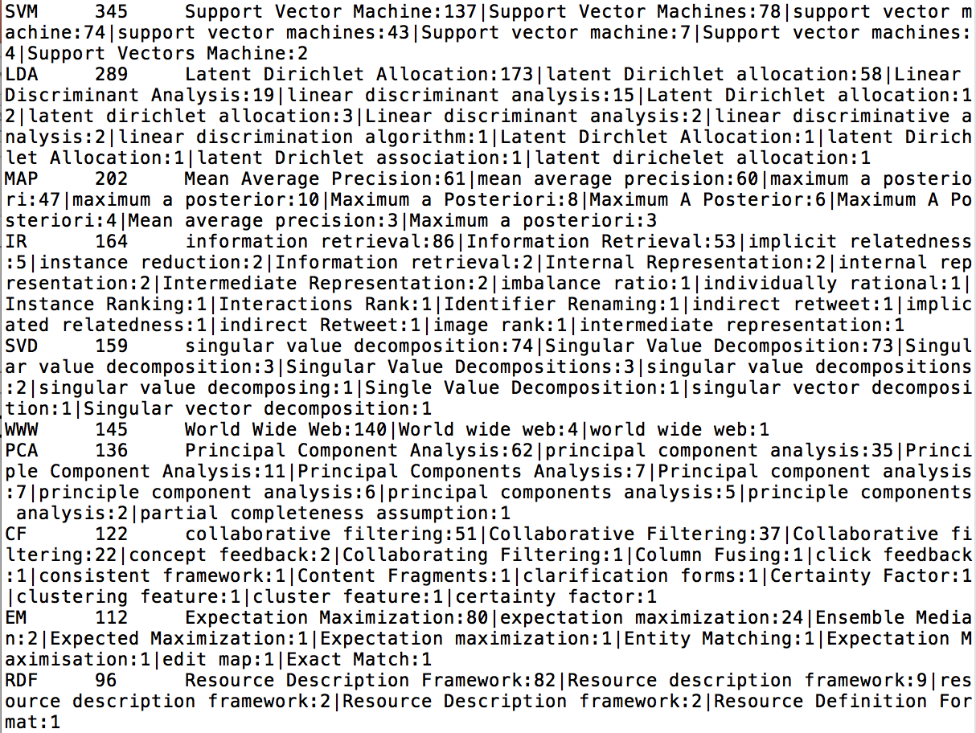
Examples (Method 3): Rule Matching

Slide 26
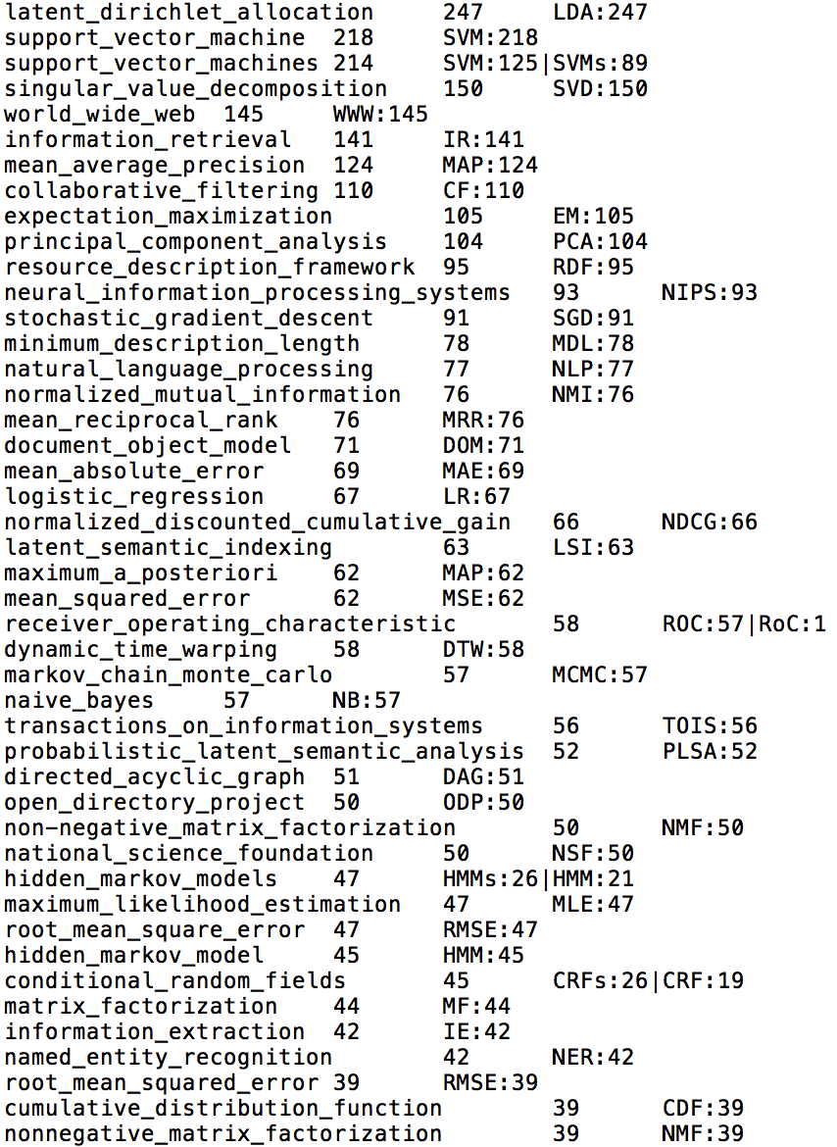
Examples (Method 3): Re-Matching for Support

Slide 27
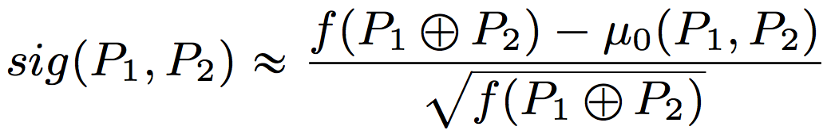
T2-2: Entity Name Quality Assessment
You are recommended to try all the measures.
Measure 1: Support (Frequency)
Sentence, Paragraph, Document
Measure 2: Outlier-ness measures (t-score, Z-score, etc.)
Other measures:
“in_this”, “at_the” …
“turn_out_to_be”, “increased_by” …
“in_this_paper” ...
“data sets”, “real data” …
Church et al. https://pdfs.semanticscholar.org/ccd5/898c79f90c25e24222410d5613edfd007985.pdf
Pedersen. http://www.d.umn.edu/~tpederse/Pubs/scsug96.pdf
El-Kishky et al. http://www.vldb.org/pvldb/vol8/p305-ElKishky.pdf
“bayesian matrix factorization”?
Thresholds?
Classification?

Slide 28
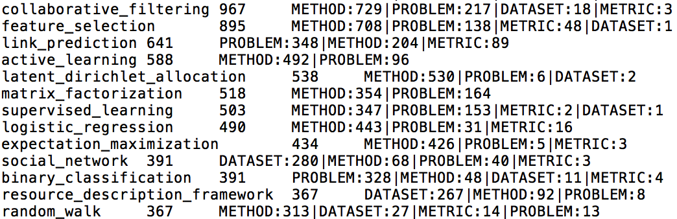
Task 3: Entity Typing
Trigger words
METHOD: method algorithm model approach framework process scheme implementation procedure strategy architecture
PROBLEM: problem technique process system application task evaluation tool paradigm benchmark software
DATASET: data dataset database
METRIC: value score measure metric function parameter
Classification using contextual features and Evaluation

Slide 29
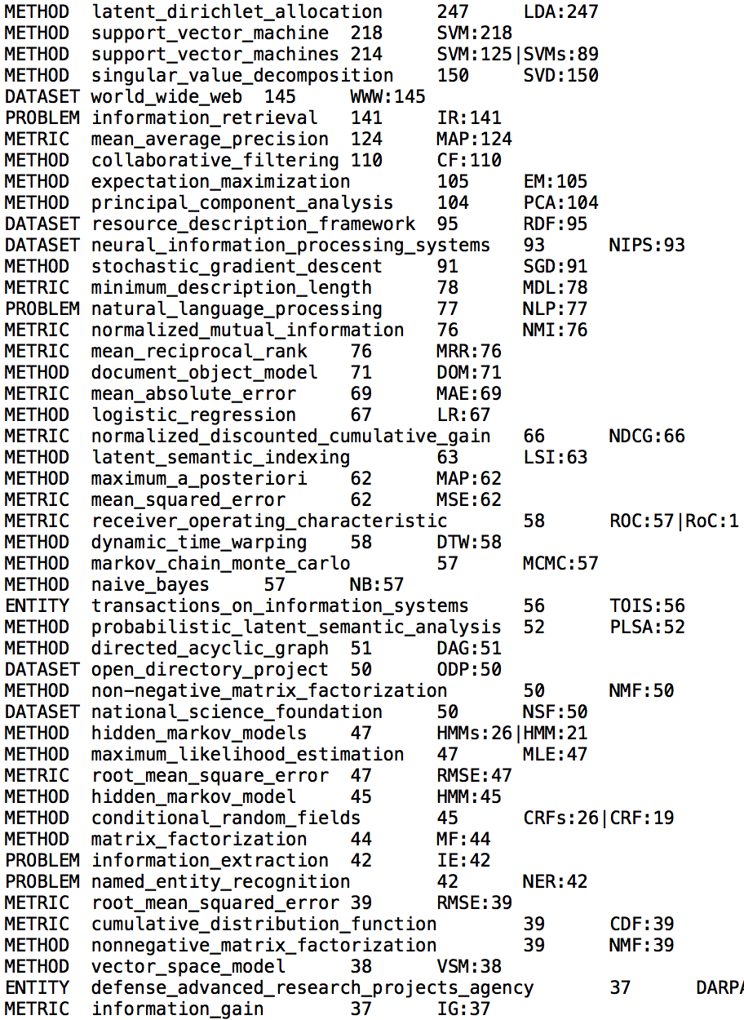
Examples (Entity Typing)

Slide 30
Review: Seven Required Tasks
T1: Data cleaning and data integration (D.P.)
T2: Entity name recognition (D.P.)
T3: Entity typing (D.P./Cla.) + Eval.
T4: Collaboration discovery (F.P.M.)
T5: Problem-method association mining (A.R.M.)
T6: Problem/method/author classification (Cla.) + Eval.
T7: Paper clustering (Clu.) + Eval.
D.P. = Data preprocessing; Cla. = Classification
F.P.M. = Frequent pattern mining; Clu. = Clustering
A.R.M. = Association rule mining

Slide 31
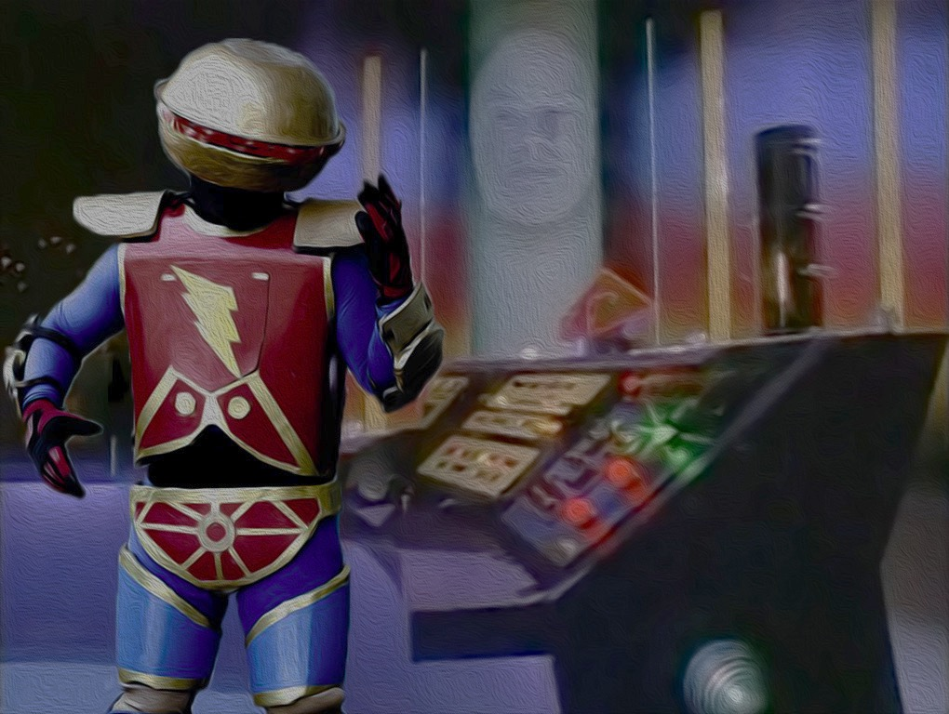
SciBot: Magic powers in hand now!
But can you build a nice GUI for me?
And can you write a GuideBook for Dr. Zordon?

Slide 32
Policy, Requirement, Grading before Recommended Tasks
Students are also required to write a project report / paper to describe their achievement including the following points for each task: (1) Motivation and task definition, (2) Approach, (3) Results, and (4) Discussions.
Students are required to submit their code package + “readme” (.ZIP) and project report/paper (.PDF). There is no paper template requirement.
The project due is Nov 30, 2017. There will be NO extension. Significant updates are welcome before the final exam – students can send updates to the instructor after the due by e-mail but they have to submit one version before the due.
HWs will be designed to follow-up your progress ☺
Milestones

Slide 33
Milestones!!!
T1: Data cleaning and data integration (D.P.)
T2: Entity name recognition (D.P.) – HW3 (Oct. 3)
T3: Entity typing (D.P./Cla.) + Eval.
T4: Collaboration discovery (F.P.M.)
T5: Problem-method association mining (A.R.M.) – HW4 (Nov. 9)
T6: Problem/method/author classification (Cla.) + Eval.
T7: Paper clustering (Clu.) + Eval.
D.P. = Data preprocessing; Cla. = Classification
F.P.M. = Frequent pattern mining; Clu. = Clustering
A.R.M. = Association rule mining – Project (Nov. 30)

Slide 34

Individual Project!
[updated Sept. 28, 2017]

Slide 35
Team Project
A team will have at most 2 members.
Students will give their partner’s name (or N/A – if by their own) in HW3.
Members in the same team will have the same score.
In last two lectures we tend to grade individual projects/undergraduates better than team projects/graduates if they generate the same results.
[updated Sept. 28, 2017]

Slide 36
Grading
Students will volunteer to present their SciBot (tech and results) in the last two lectures. Classmates and the instructor will grade them based on the presentation. For the students who do not present, the instructor will grade their projects after all the lectures end. Note that we will have comparative grading – finishing all the required tasks cannot make sure that you have all points – but finishing in high quality yes – or you can have all points if you do required tasks in low quality but some more tasks.
Graders should have higher expectations on graduates than undergraduates – not only on the project results (more tasks, better performances) but also on writing (a workshop-quality paper of strong reasoning). Undergraduates will be applied with a uniform grading policy no matter what majors they have.
[updated Sept. 28, 2017]

Slide 37
What Are Encouraged?
Students are encouraged to implement algorithms such as Apriori, FP-Growth, and K- Means Clustering by themselves instead of calling Python packages.
Students are also encouraged to use Python packages (e.g., numpy and scipy) when they use advanced techniques (e.g., SVMs, Neural Networks, word2vec) to address challenging tasks.
Students are encouraged to compare different methods on the same task and discuss their advantages and disadvantages. Reasoning is always welcome in the paper.
Students are encouraged to share any annotation data (e.g., labels, hand-crafted rules) but not any segment of codes.
Students are encouraged to make a GUI for the SciBot. They are also encouraged to give a better name to their bots than “SciBot”.
https://piazza.com/class/j6dmfs52c6d5ov

Slide 38

Your SciBot

Slide 39

FAQ
Q1:
A1:
Q2:
A2:
Next: Recommended tasks

Slide 40
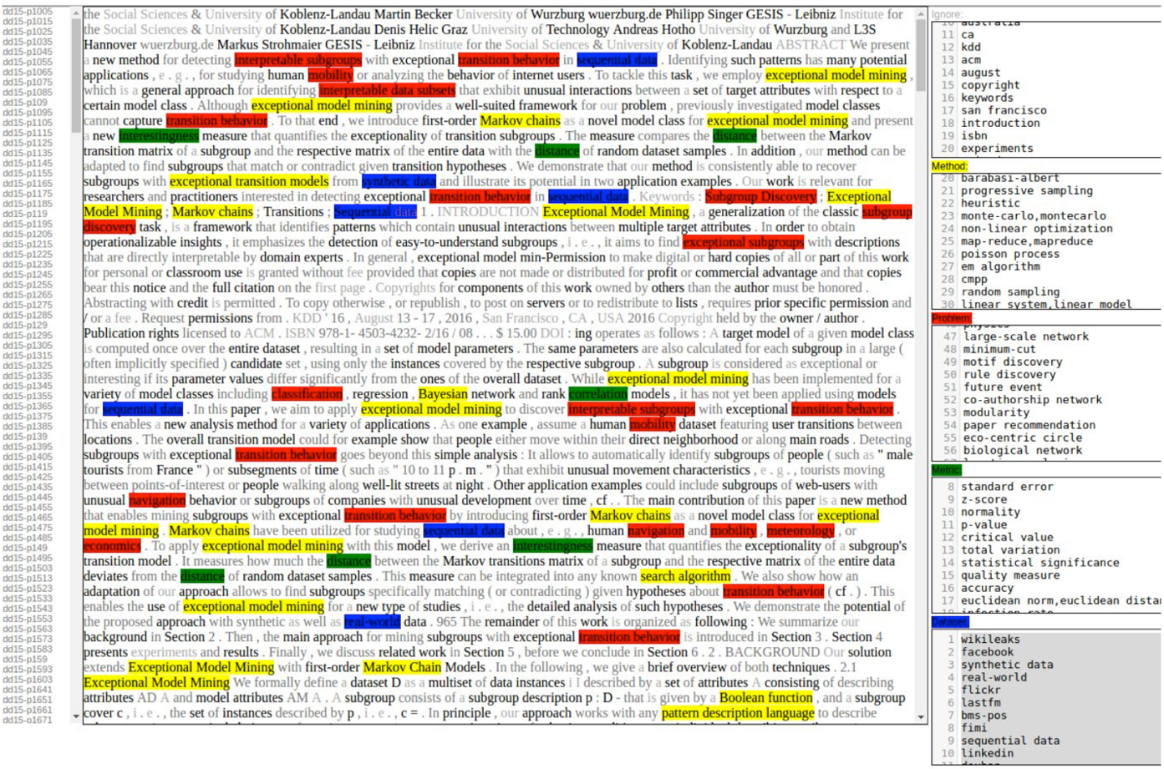
WebUI for Annotation
From UIUC CS412 Summer’17

Slide 41
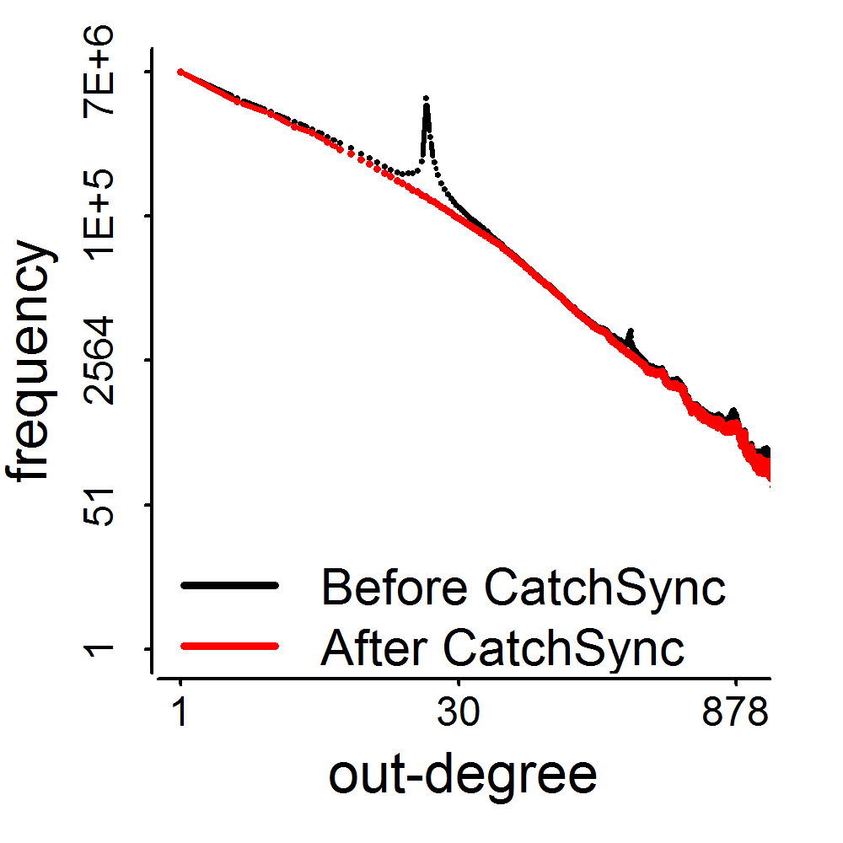
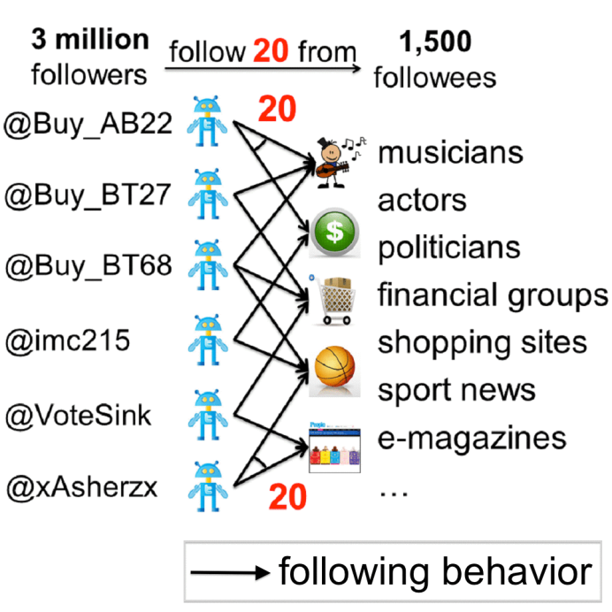
Task 1+: Degree Distributions
Regression
Linear, Power-law
Poisson, Gaussian
3.17M
0.41M
d=20
CatchSync (KDD’14): http://www.meng-jiang.com/pubs/catchsync-kdd14/catchsync-kdd14-paper.pdf
KONECT network collection: http://konect.uni-koblenz.de/networks/

Slide 42
Task 3+: Entity Cluster Typing
First entity clustering and then typing
High confidence on one entity’s type will help to type other entities in the same cluster
What are the features for entity clustering?

Slide 43
Task 4+: Advisor-Advisee Discovery
Beyond collaborations
First-last-author rule
Measuring proximity with Kulc measure
Correlation between them
Ground-truth and evaluation

Slide 44
Task 8: SciCube
Given enriched structured data, can we construct a data cube and compute iceberg cubes for query-based applications?
E.g., expert recommendation: Given a problem, list authors, papers and other information that help related research.
Techs: Data cube, iceberg cube, closed cells, etc.
Hints:
Each paper is considered as a transaction. The cell maintains a set of papers. A paper may be in multiple cells. We count the size of paper set for the cube computation.
For a list of entities, the attribute types are dimensions (e.g., problem, method, dataset, author, conference); the attribute values are the dimension values (e.g., “naïve bayes”, “decision tree”).
More functionalities of the data cube, and efficiency analysis are welcome.

Slide 45
Task 9: Pattern-based Entity Recognition and Typing
Given entity names, can we find frequent patterns around the entities? We replace concrete entity names as “$Entity.” You can find more entities via pattern matching.
Given seed typed entities (methods, problems, etc.), can we find concrete frequent patterns around the typed entities? We replace concrete method/problem entities as “$Method”/“$Problem”. Those patterns indicate that you may be able to find more entities of the specific types.
Techs: Constraint-based frequent pattern mining.
Hints:
An iterative process that first generate and evaluate the support of patterns such as “problem of $Problem”, “address $Problem problem”, “propose $Method method”, “approach based on $Method”, “propose $Method for $Problem”, “address $Problem using $Method” and then recognize more entities and their types by matching the patterns in the text and repeat until convergence.

Slide 46
Hint: Pattern Matching
How to match the text with patterns efficiently?
Suppose we have 6 patterns: “problem of $Problem”, “address $Problem problem”, “propose $Method method”, “approach based on $Method”, “propose $Method for $Problem”, “address $Problem using $Method”.
Match string patterns???

Slide 47
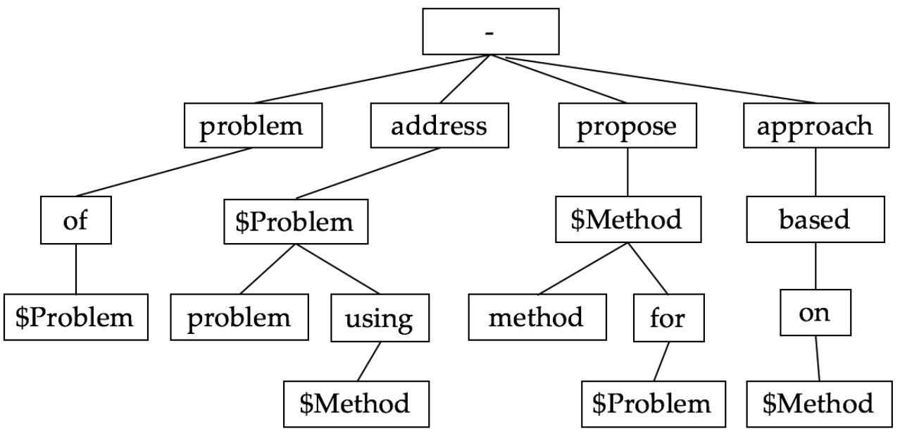
Hint: Pattern Matching
How to match the text with patterns efficiently?
Suppose we have 6 patterns: “problem of $Problem”, “address $Problem problem”, “propose $Method method”, “approach based on $Method”, “propose $Method for $Problem”, “address $Problem using $Method”.
The data structure of Trie Tree (https://en.wikipedia.org/wiki/Trie) is recommended.

Slide 48
Other Tasks
Task 10: Problem/method/author clustering
Given a set of problems/methods/authors, cluster them into K groups. Evaluate the clustering results in a proper way.
Techs: K-partitioning clustering methods (K-Means).
Task 11: Attribute discovery
Suppose we use rules to type digit number as $Digit. Can we find the size of datasets used in the papers? Can we find the performance of methods?
Techs: Constraint-based frequent pattern mining.
Task 12: Ensemble learning
Suppose we have multiple models/methods for a specific task (actually you do have if you’ve finished the required tasks). Can we use ensemble methods to further improve the performance?
Techs: Ensemble methods (bagging, Adaboost, etc.).

Slide 49
Other Tasks (cont.)
Task 13: Practice with advanced classification and clustering methods
Can you solve the above tasks with advanced classification models (e.g., SVMs, Neural Networks) and clustering methods (e.g., spectral clustering)?
Task 14: Other interesting tasks related to other data entries/attribute:
Affiliation ranking on a specific method/problem
Task 15: Data visualization is encouraged.

Slide 50
Dr. Zordon: What’s your grade?
SciBot: I did all the tasks – I got an A! And I save you 20 * $150,000 = $3,000,000 per year!
I want more papers. Feed me more data.
(10 days later)
SciBot: I am more knowledgeable than you.
I am your BOSS!

Slide 51

Enjoy the Power-Rangers Project ☺

